Slide 1
Communications approach
at
Grains & Legumes
Nutrition Council
Kathy La Macchia
March 2022

Slide 2
Who we are
Group of credible, independent experts on grains & legumes nutrition
We are a Health Promotion Charity and a non-profit organization
We promote grains and legumes as part of a balanced diet through evidence-based information
We work with grains and legumes research associations, millers and food industry
We focus our communications to health care professional- dietitians, influencers and consumers

Slide 3
Communications tools we use
FOR CONSUMERS
Social media- Instagram, facebook
Run national and global campaigns
Connect with influencers
Recipe promotion and nutrition facts and myth busters
Newsletters for our consumers
On pack communications
Little paid advertising in womens and health magazines

Slide 4
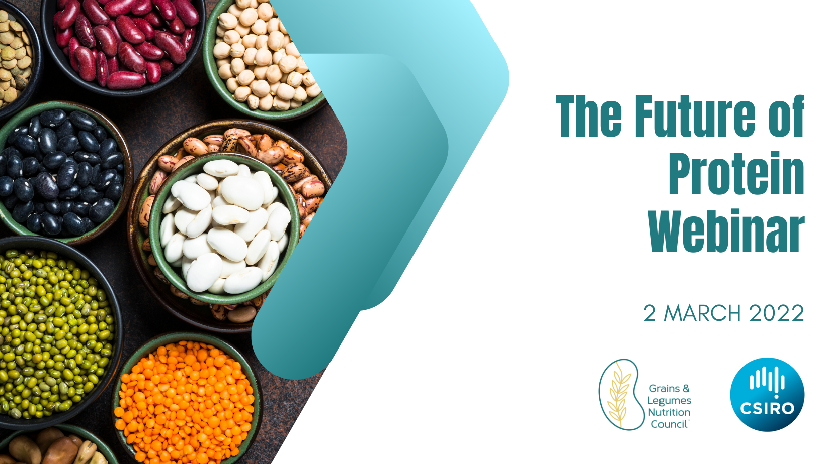
Communications tools we use
FOR HEALTH CAE PROFESSIONALS
Social media- Facebook and Twitter
Webinars
Media releases on research
Product and recipe spotlights
Ready reckoners, fact sheets
Audit updates

Slide 5
Do Partners communicate simultaneously?
We aim to work collaboratively especially for research release and campaigns eg wholegrains week
We work with main stakeholders communication style depends on message
We focus on high level detail communication to health care professionals & key messages for infleuncers & consumers
We discuss with our partners who will do what media and ensure all syncronised
Also work with Nutrition partners for key promotions and capaigns

Slide 6
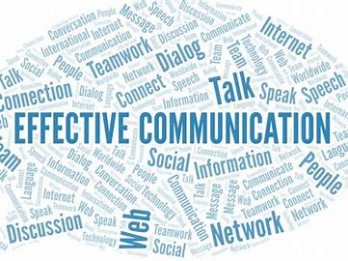
What is most important for good communications?
Communication strategy
Planning and Budget
Collaboration with partners
Understand the audience
Focus on right language and tone
Keep it short and sharp

